Slide 1
Final presentation Mobile App Programming:
STech Buddies
Klaudia KUBALE Rayane BEN YACOUB

Slide 2
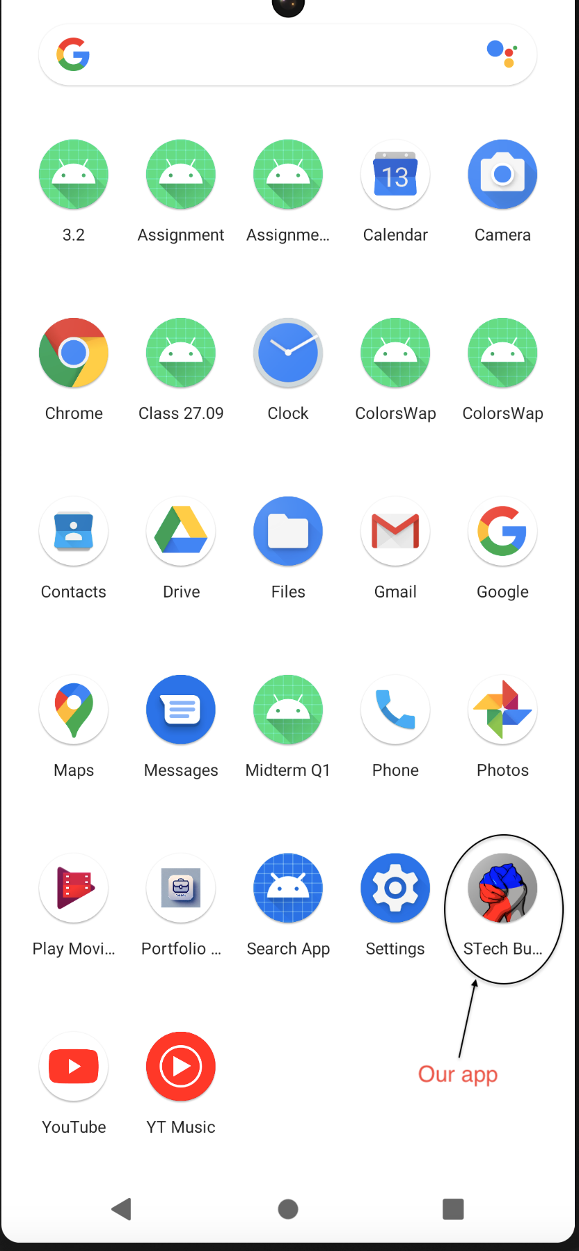
Table of content
Architecture
Features
Intended features
Conclusion

Slide 3
Architecture
MVVM-Like Structure:
Model: Handles data (Message, Group, WeatherResponse)
View: XML layout define the UI
Controller (Activities/Fragments): Manage UI updates, API calls, and user interactions
Firebase integration (Authentication, Firestore, Messaging)
APIs (ChatGPT and OpenWeather)
Libraries: Retrofit, Material Calendar, OkHttp, Firebase SDKs, etc…

Slide 4
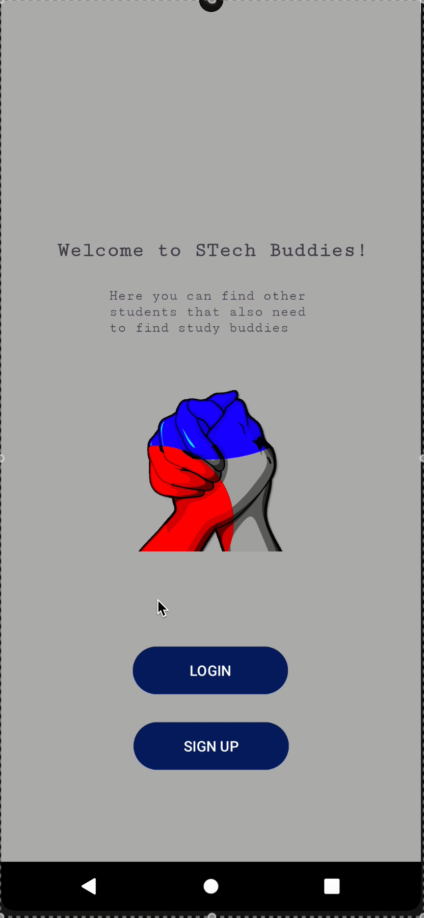
Sign In/Sign Up
Login with email and password
Sign up register users’ information in firebase
Logo
Technical methods:
Firebase Authentication
Firestore database to store profiles
Encrypting the password
Spinner, toasts, …

Slide 5
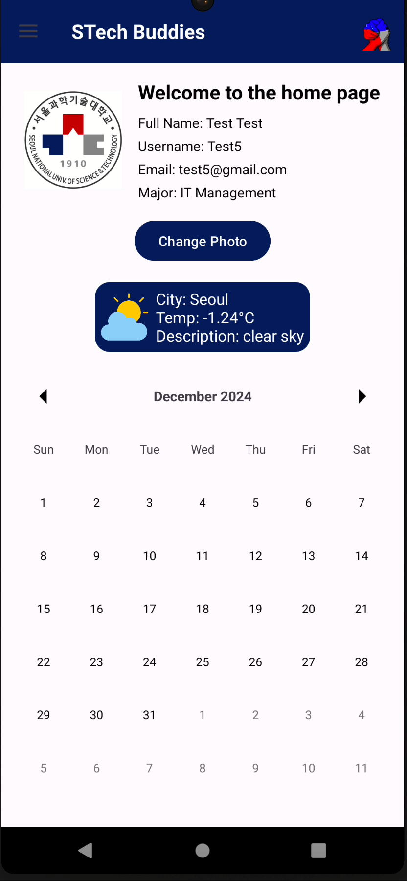
Home page
Displaying user information and today’s weather
Calendar with event creations
Change profile picture
Technical methods:
Permission handling for photos
Pop-up message appear when clicking on a date to add an event
Weather API Open Weather Map
Material Calendar

Slide 6
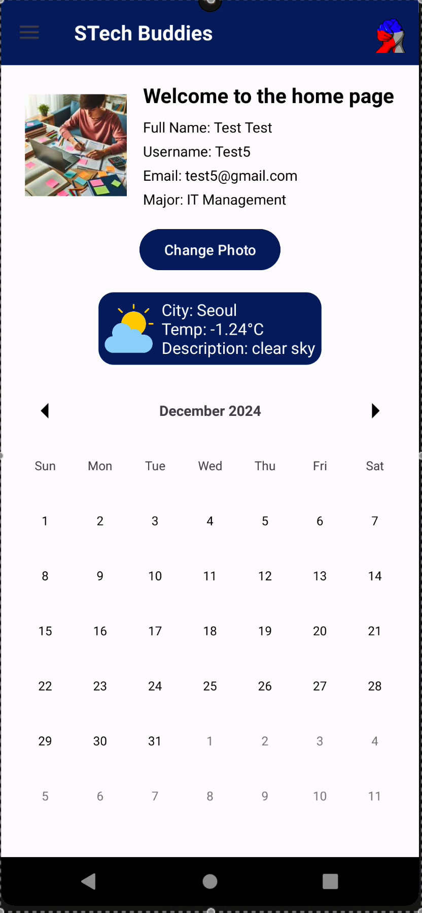
Groups
Displaying groups from the major you choose
Join/leave or create a group
Display group information
Can’t create a group with a name already taken
Technical methods:
Recycler view, Spinner (dynamic display)
Group storage with Firestore
Alert Dialog
Error handling

Slide 7
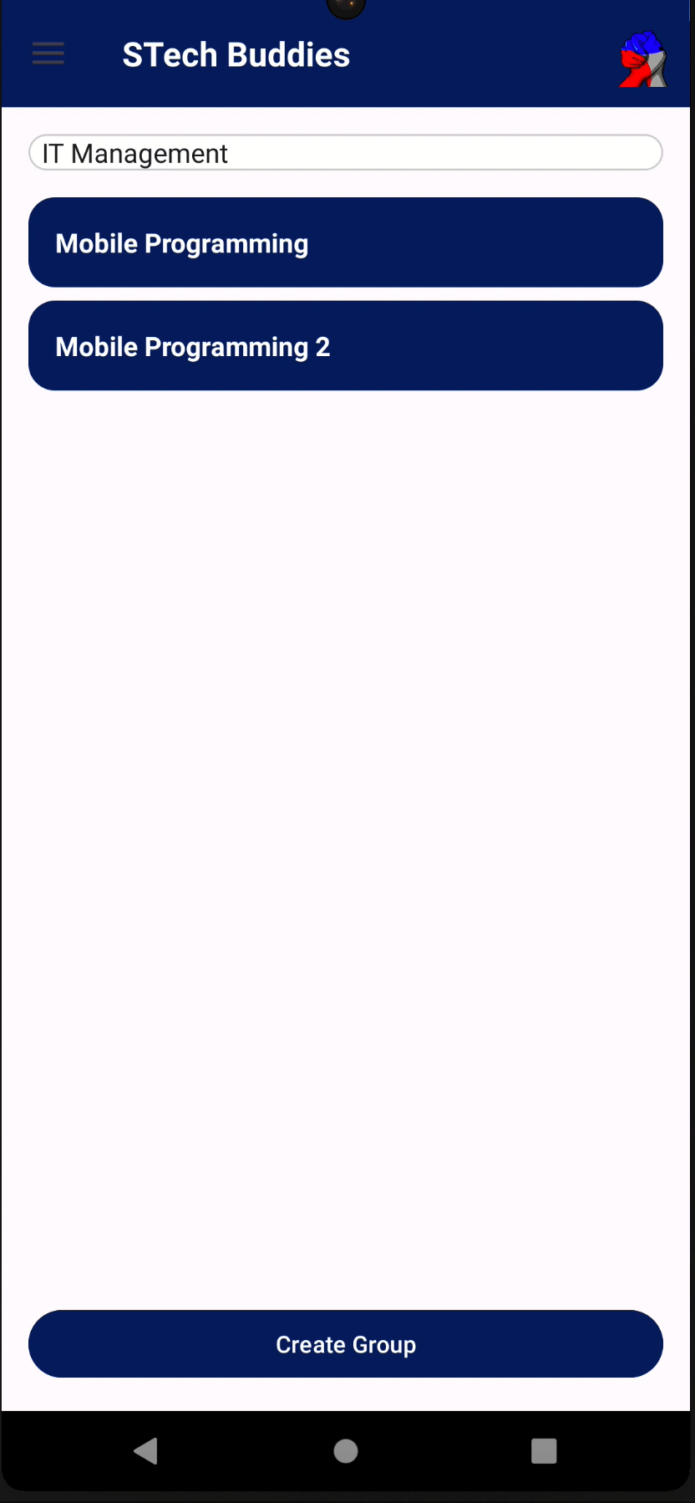
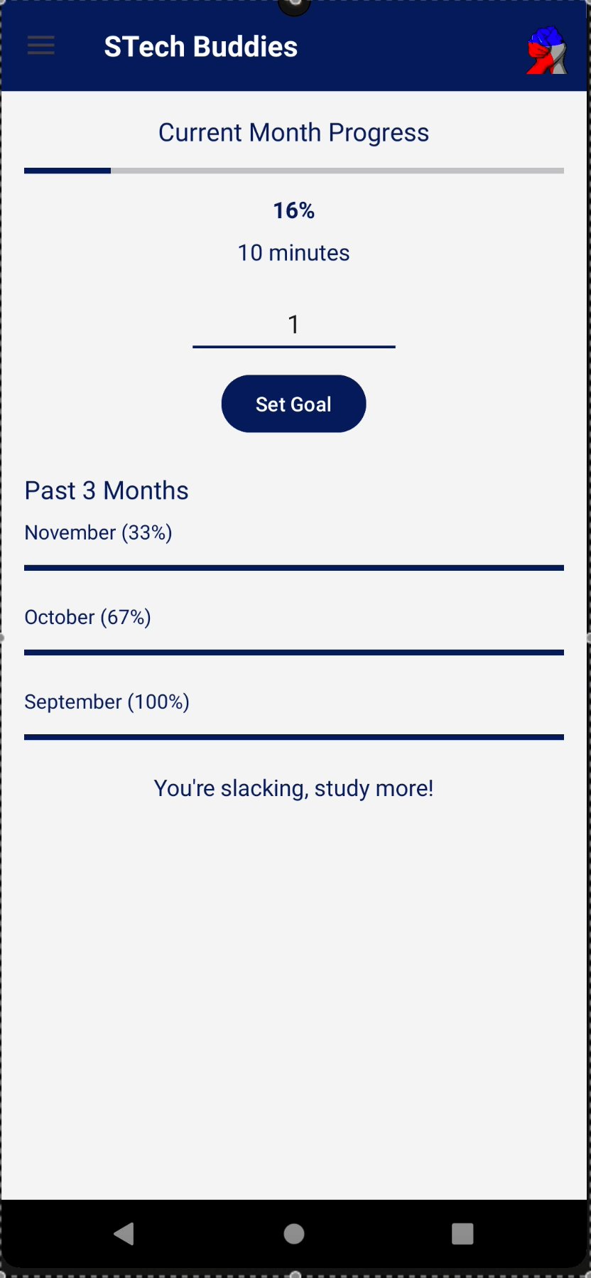
Chatrooms
Access to a group chatroom
Chatroom text sending
Fail to implement file sending and audio recordings
Technical methods:
Recycler View (dynamic)
Send a message via Firebase Cloud Messaging
Message storage with Firestore
Real-time message update

Slide 8
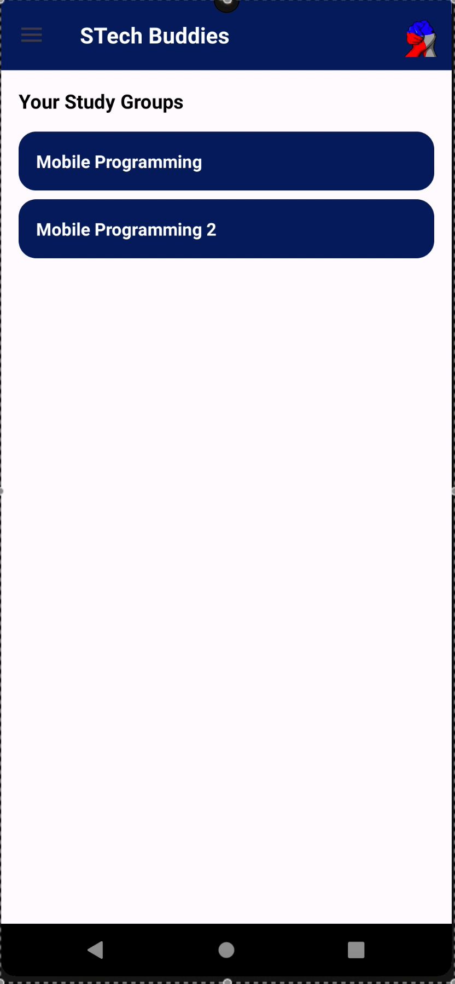
Tutoring with ChatGPT
Prompt a code and receive response
Error message when the maximum amount of request have been used
Technical methods:
Chat GPT API (not free)
Retrofit to call endpoint
Error handling (toast)

Slide 9
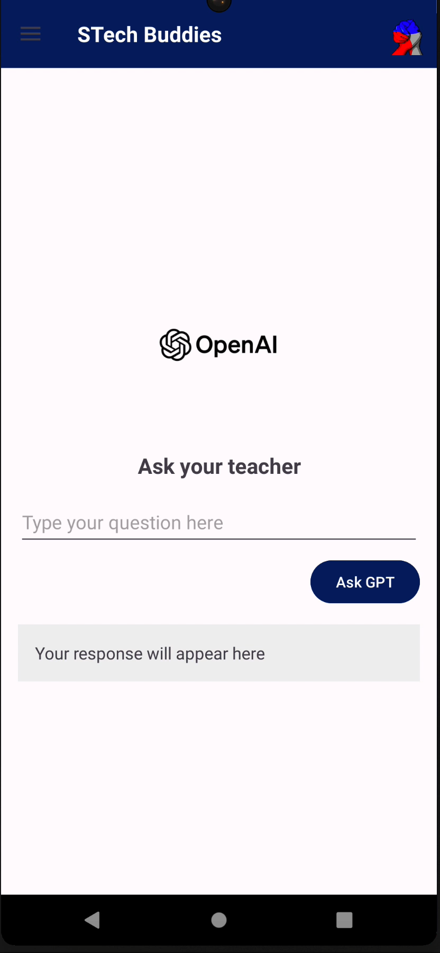
Timer
Pomodoro Timer (start, pause, reset)
Automatic restart
Time saved in stats
Custom presets (study/break time)
Progress Bar
Sound + vibration for end timer
Technical methods:
State persistence (shared preferences)
Saved study time

Slide 10
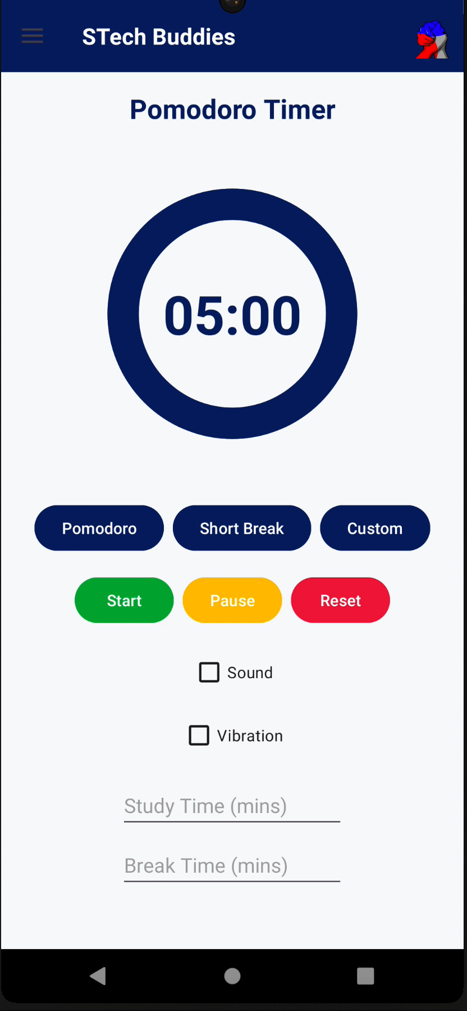
Statistics
Study goal time (progress bar)
Past months study time displayed
Dynamically recovers monthly study data time
Dynamically set motivational text depending on progress towards goal
Technical methods:
Shared Preferences study time
Past months data

Slide 11
Intended features
Calendar with Google Calendar API
Map with Naver maps API
Drive repository with Google Drive
Audio recording and file sending
Group event creation (detailed)
Ranking system for study time
Advanced UI features
These features have not been implemented because of lack of time or capabilities

Slide 12
GITHUB
Conclusion
Faced challenges implementing some functionalities
Prioritized core functionalities over advanced features to ensure a stable and functional application.
User Interface (UI) remains basic
Roles differed as we advanced on the project
Diverted a bit for initial plan

Slide 13

GITHUB
End
https://github.com/Klaudia65/STech_buddies/tree/final_project

